Slide 1
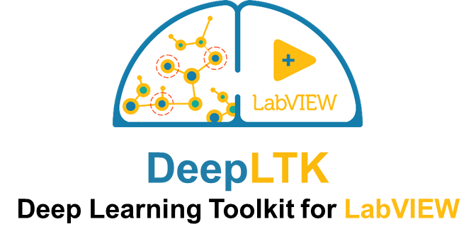


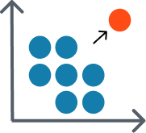




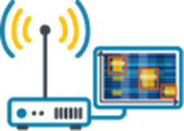
DeepLTK - Deep Learning Toolkit for LabVIEW
High level API for:
  Building
  Training
  Evaluation
  Optimization
  Deployment
Complete implementation in LabVIEW
GPU Acceleration
Deployment on NI’s embedded targets
Inference acceleration on FPGAs
Image
Classification
Object Detection
Anomaly Detection
Speech Recognition
Waveform Analysis
Semantic
Segmentation
Tabular Data
Analysis
Time Series Prediction
Signal
Intelligence

Slide 2
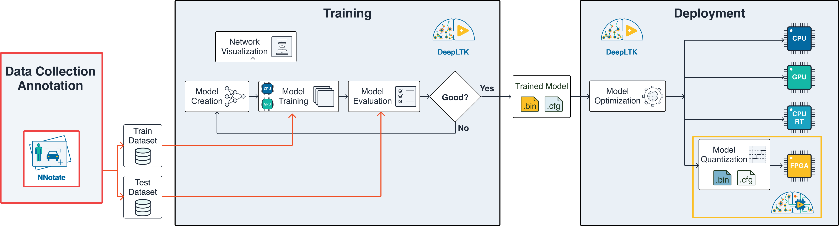
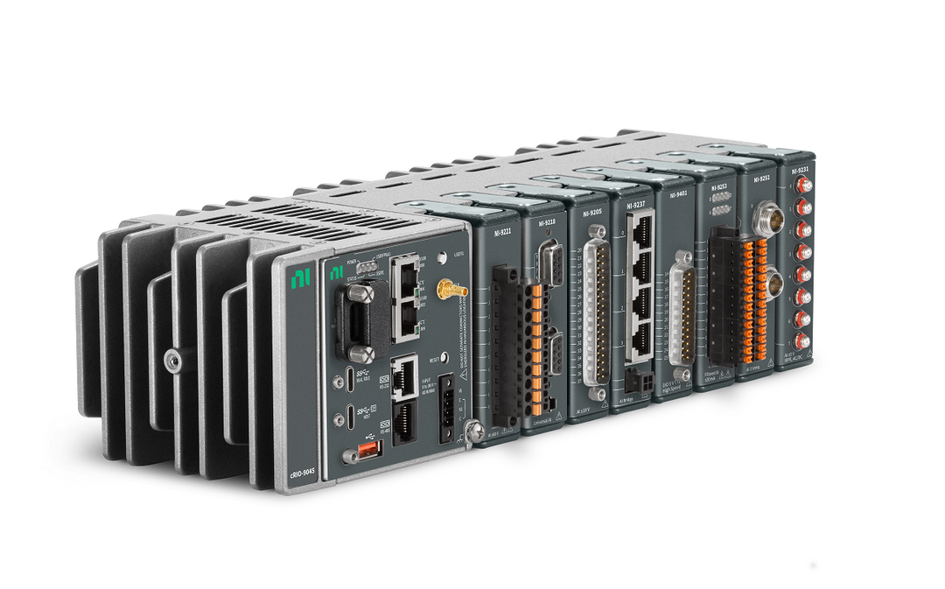
AI Model Design and Deployment Workflow with DeepLTK

Slide 3
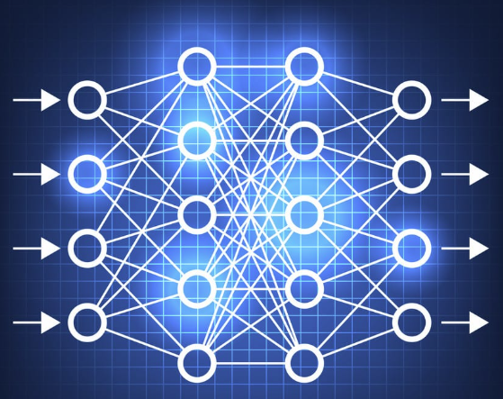
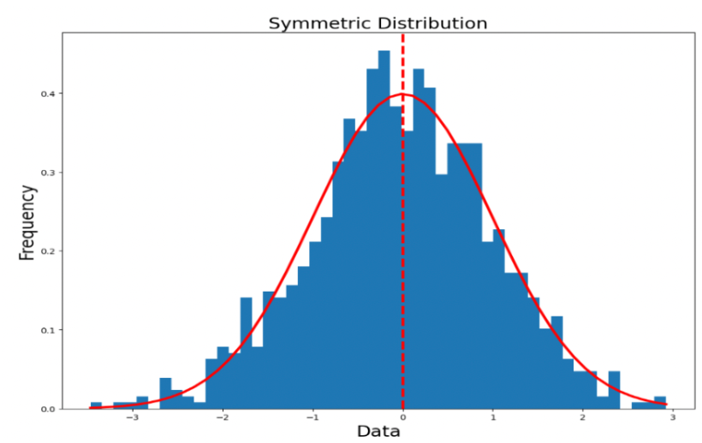
Integrating AI Inference with NI
Training
Data
Network
Training
Network
Optimization
Quantization
FPGA
I/O
CPU
GPU
Source: Ngene LLC
Notes:
Source:
https://www.aptlytech.com/ai-infrastructure-comparing-cloud-vs-edge-vs-onp/

Slide 4
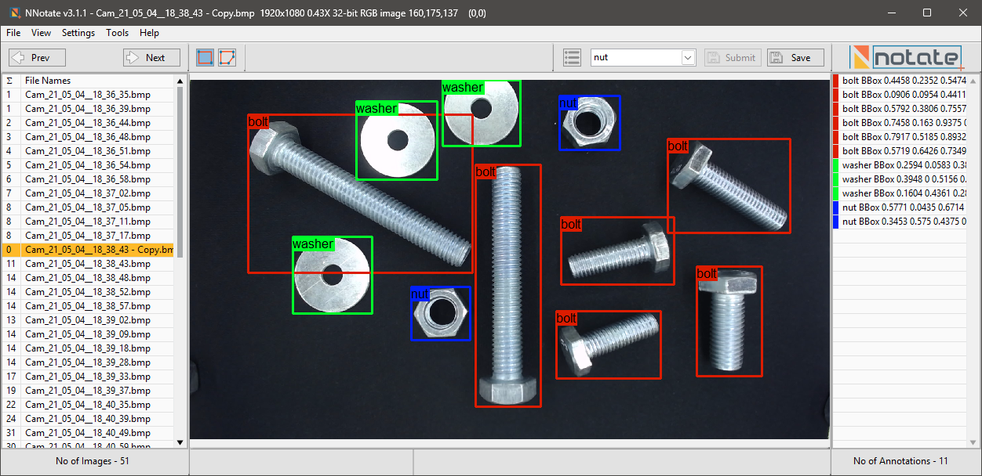
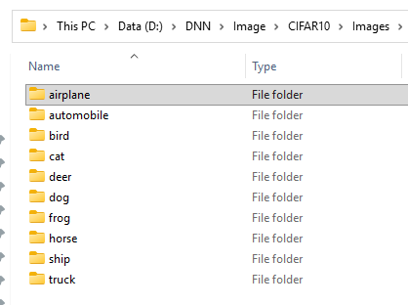
Dataset Representation
Object Detection
Classification
Pixelwise Segmentation

Slide 5
Integrating AI Inference with NI
Training
Data
Network
Training
Network
Optimization
Quantization
FPGA
I/O
CPU
GPU
Source: Ngene LLC
Notes:
Source:
https://www.aptlytech.com/ai-infrastructure-comparing-cloud-vs-edge-vs-onp/

Slide 6
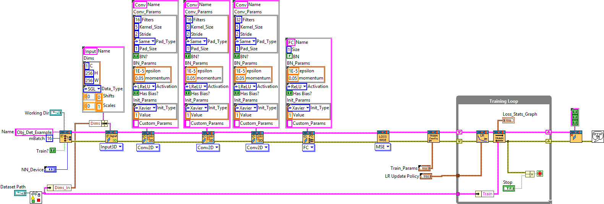
Training Neural Networks
5. Training
6. Model
Saving
3. Loss Function
4. Train
Config.
2. Model Creation
1. Dataset
Reading

Slide 7
Reference Examples for Different Applications
Basic Examples/
  1.1 Simple Logistic Regression - Boolean Operations
  1.2 Multi-Output Logistic Regression - 8bit Adder
  1.3 Linear Regression - Celsius to Fahrenheit Conversion
  1.4 Multi-Output Non-Linear Regression - Sin(x) & Cos(x)
Waveform/Signal Processing
  2.1 Waveform Signal Classification
  2.2 Waveform Signal Regression
  2.3 Power Line Fault Classification
  2.4 Waveform Anomaly Detection
  2.5 Speech Recognition (WF Classification) (TBD)
Computer Vision
  3.1 Image Regression
  3.2 Image Classification
  3.3 Object Detection (YOLO v2/4)
  3.4 Semantic Segmentation (U-Net)(TBD)
  3.6 Visual Anomaly Detection
GitHub: https://github.com/ngenehub/deepltk_examples
Tutorials: https://www.ngene.co/blog/categories/deepltk

Slide 8
Integrating AI Inference with NI
Training
Data
Network
Training
Network
Optimization
Quantization
Deployment
FPGA
I/O
CPU
GPU
Source: Ngene LLC
Notes:
Source:
https://www.aptlytech.com/ai-infrastructure-comparing-cloud-vs-edge-vs-onp/

Slide 9
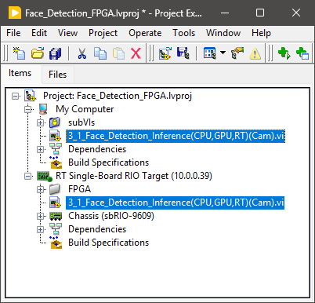
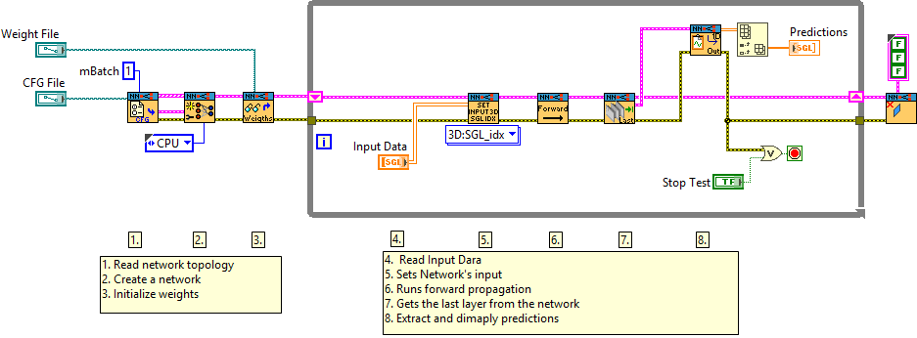
Deploying Models for Inference (Desktop vs RT)
Same VI will run on Desktop and RT.
No changes required.

Slide 10
Integrating AI Inference with NI
Training
Data
Network
Training
Network
Optimization
Quantization
FPGA
I/O
CPU
GPU
Source: Ngene LLC
Notes:
Source:
https://www.aptlytech.com/ai-infrastructure-comparing-cloud-vs-edge-vs-onp/

Slide 11
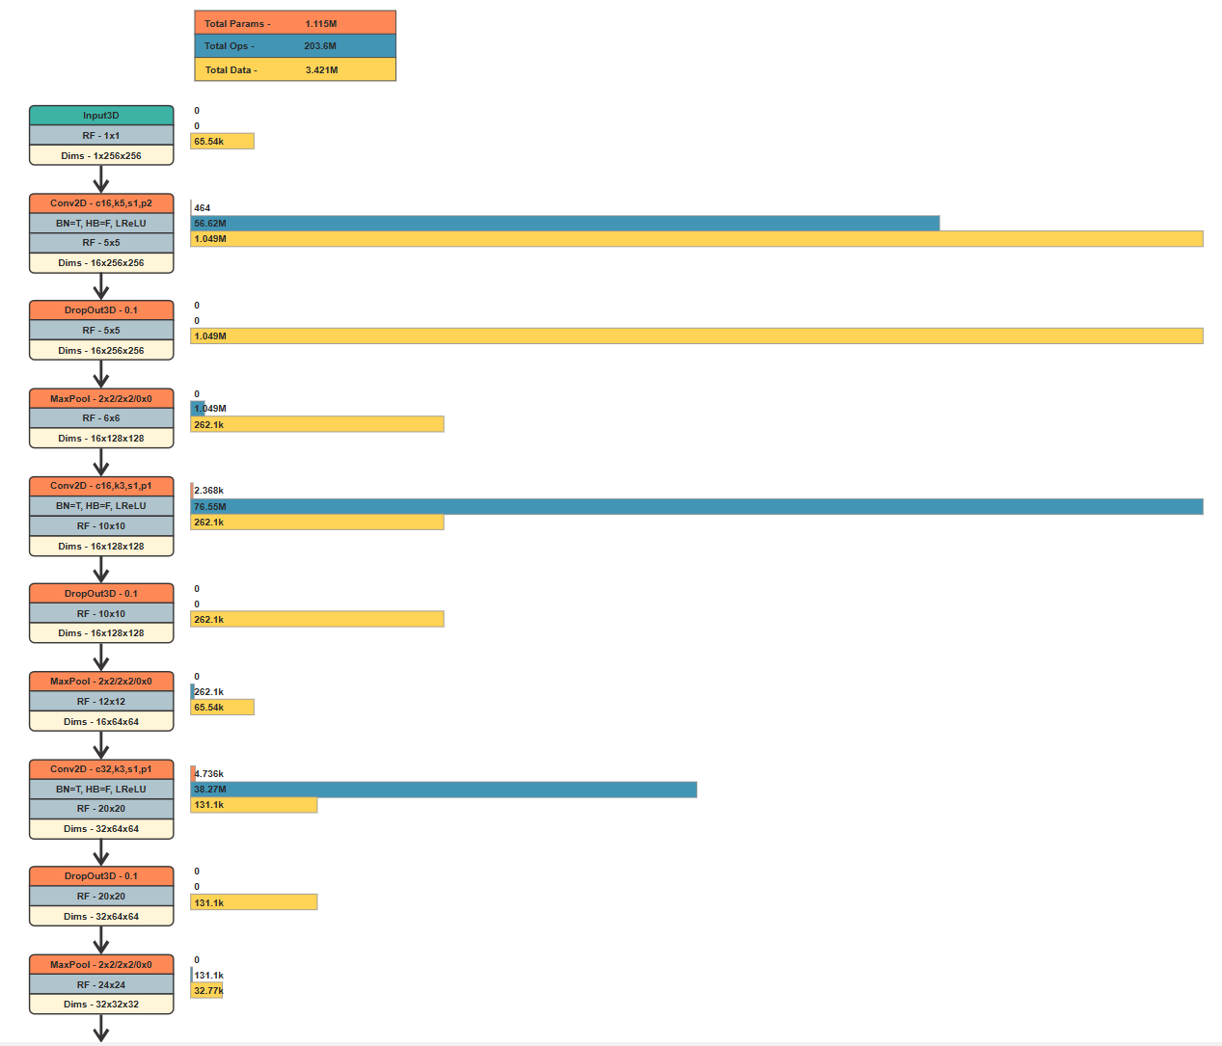
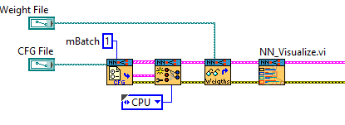
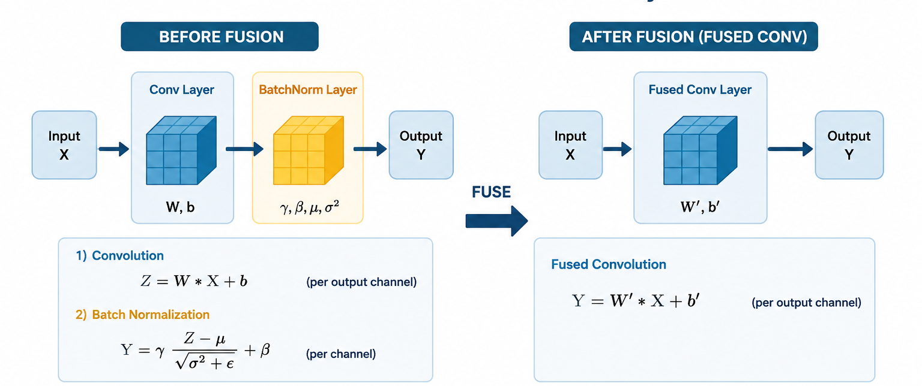
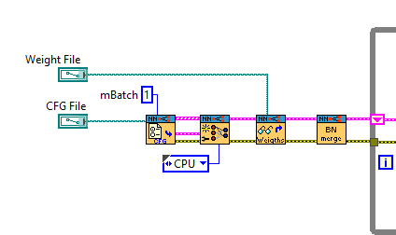
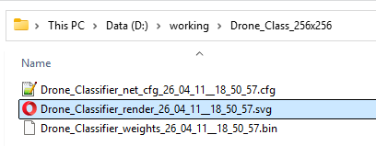
Optimizing Neural Network
Topology Optimization
Operation Fusing
+20% to speed

Slide 12
Integrating AI Inference with NI
Training
Data
Network
Training
Network
Optimization
Quantization
FPGA
I/O
CPU
GPU
Source: Ngene LLC
Notes:
Source:
https://www.aptlytech.com/ai-infrastructure-comparing-cloud-vs-edge-vs-onp/

Slide 13
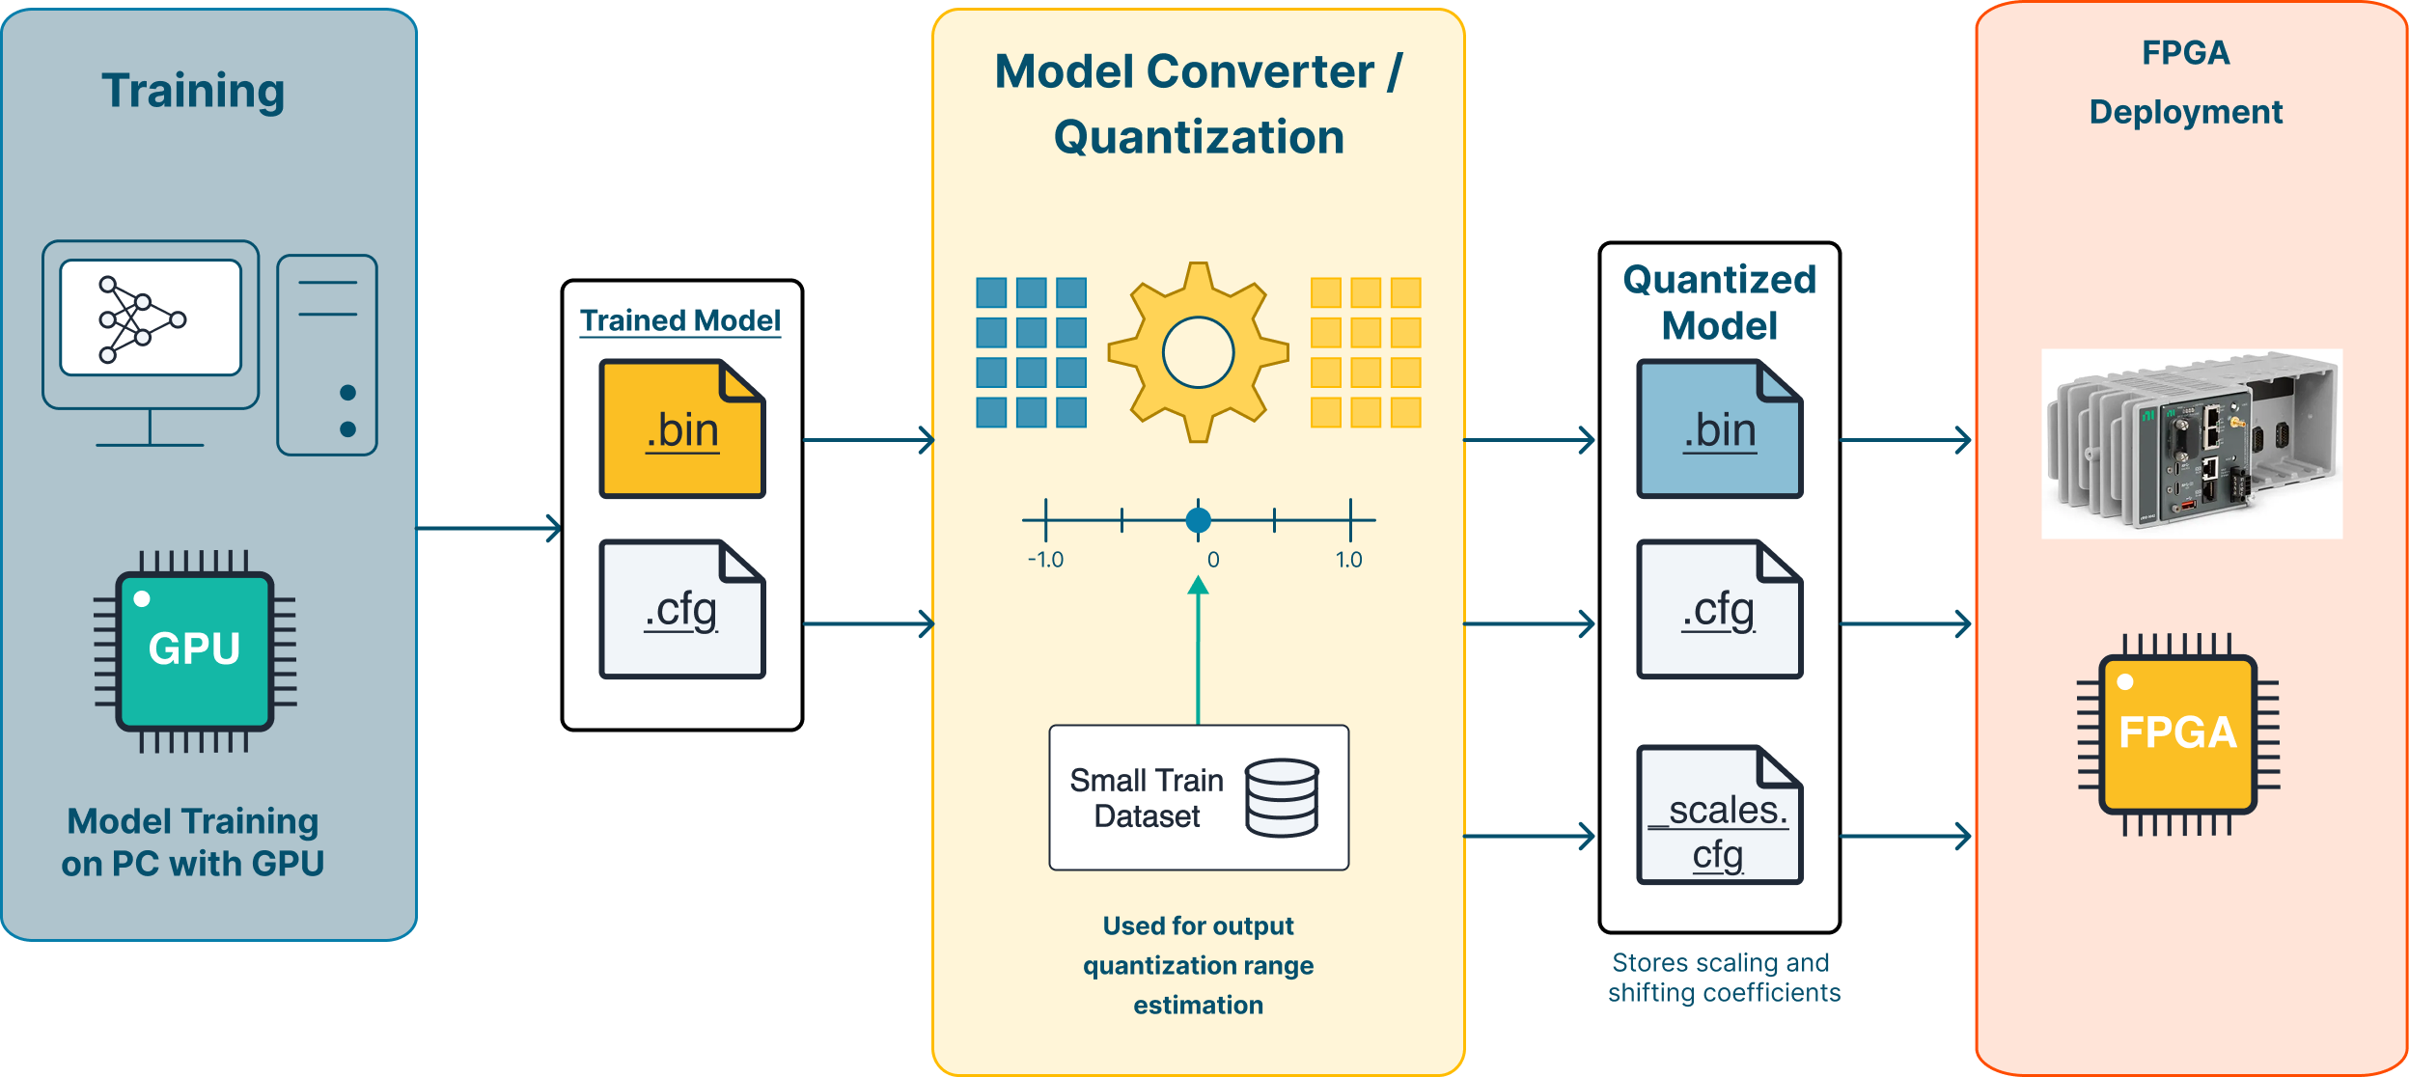
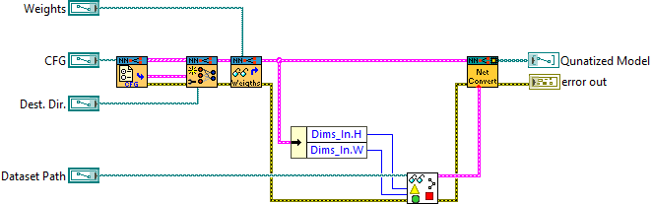
Deployment on FPGAs
FPGA hosts an engine which performs computations in Int8 format.
Model needs to be carefully quantized (SGL -> Int8) not to lose accuracy.
Special tool will perform optimal quantization automatically.
Automatic Model Quantizer/Converter

Slide 14
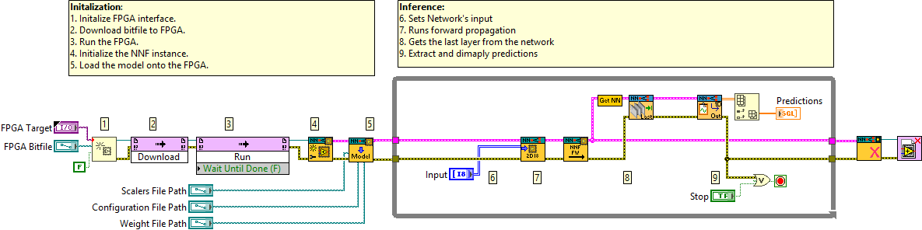
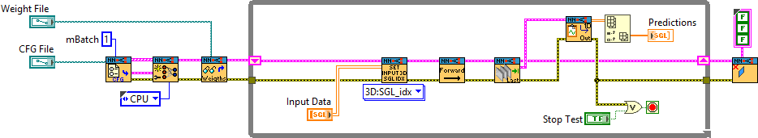
Inference Acceleration on FPGAs
vs

Slide 15
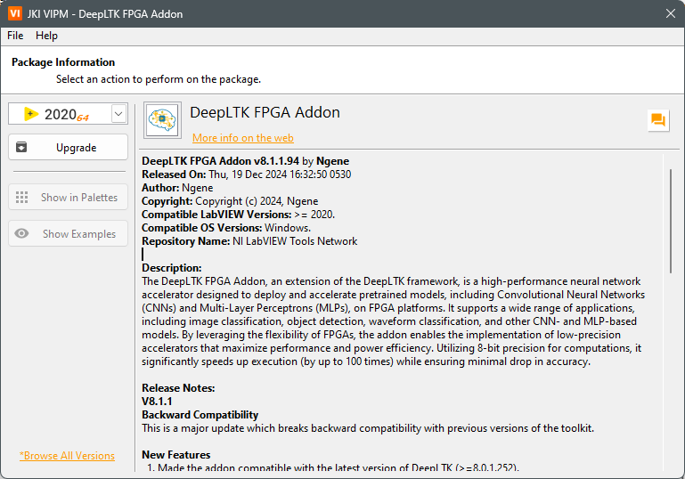
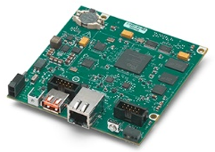
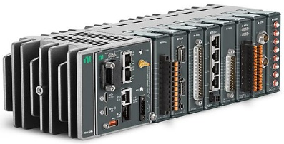
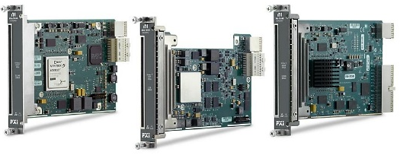
FPGA Accelerator Addon
Features
Framework for pretrained model conversion (8bit Quantization, Normalization)
High-level API for deploying pretrained models with LabVIEW
>100GOPs performance on Kintex-7 FPGA family
100FPS face detection on NI’s sbRIO-9609
8-bit precision for activations and weights
Supported layers:
  Conv kernel size: 3x3, 1x1
  MaxPool
  Fully Connected (FC)
Maximum Image resolution: 512x512px
Maximum number of layers: 32
Supports ALL NI FPGA based devices: Kintex-7, Zynq-700, etc.

Slide 16
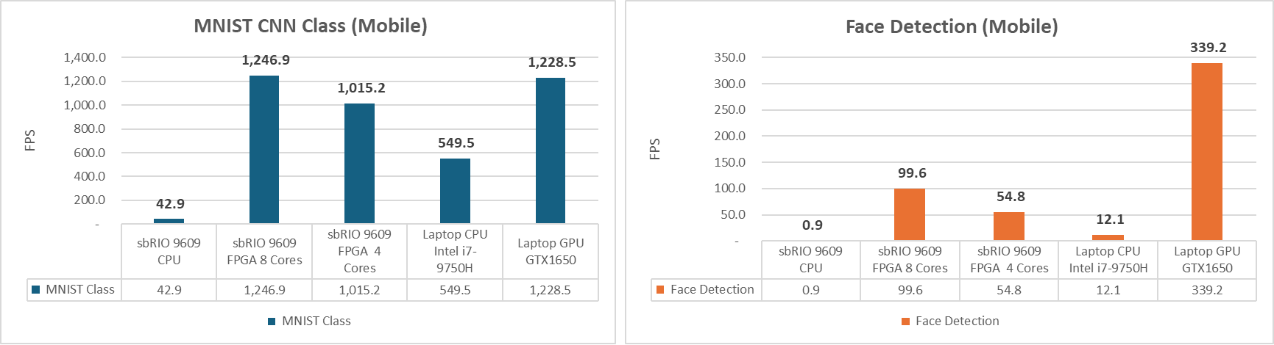
Benchmarks
>1kHz loop rate
100x speed: FPGA vs RT CPU

Slide 17
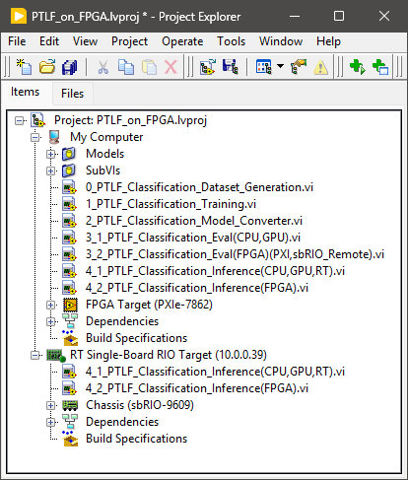
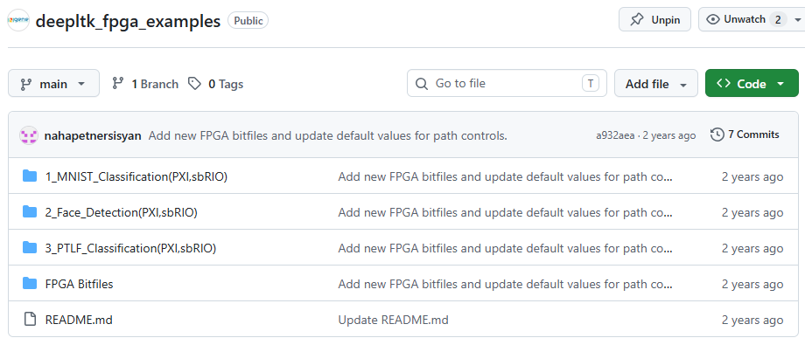
Reference Example
GitHub: https://github.com/ngenehub/deepltk_fpga_examples

